Slide 1


Corporate Systems TFS migration to Azure DevOps
FPO
Robert Murdoch
Manager of Development Support
Investments & Corporate IT
+1 980 867 7105
Robert.murdocht@aig.com
End User Update #1
Q4 2019

Slide 2
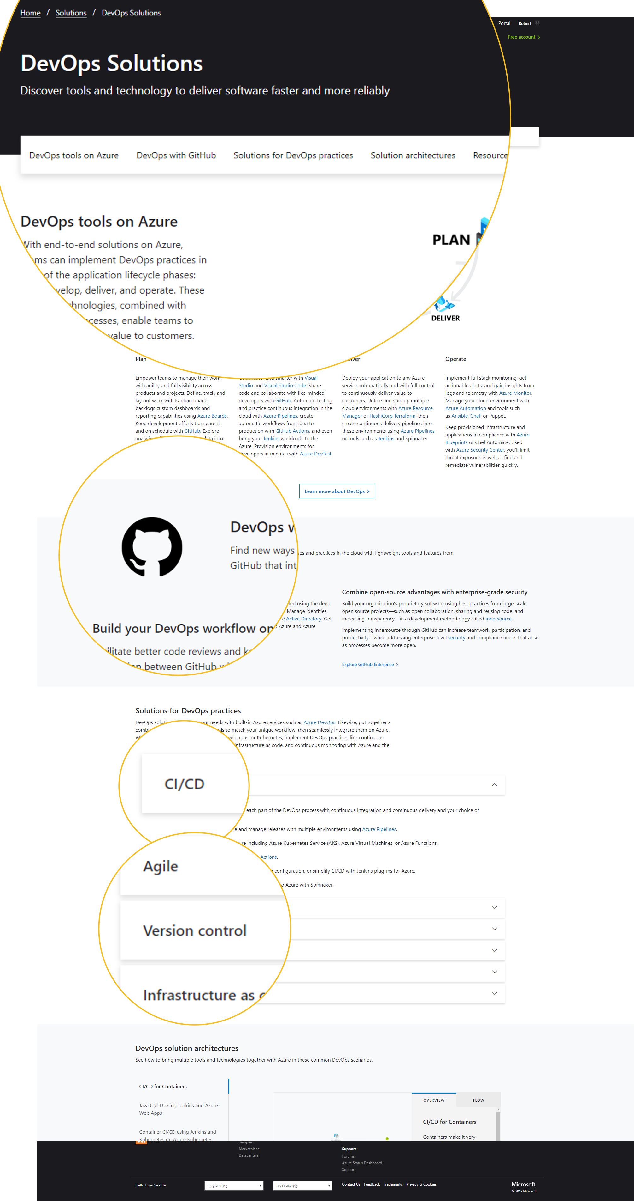
Rundown
Themes of the project
This announcement, this deck, this meeting, the first email, etc.
AIG customizations no longer supported
Identity and access management changes
New user experience
Nuance
Timeline
Notes:
One of the things we do has become widely referred to as that’s the release team.
For the purposes of our operating model, I make a distinction between what people collectively refer to as the release team and the engineering and administration work.
We are owners of some GEAR applications
I hope to give you a mental model of where we are currently with regarding these three things as well as where we are investing in 2019

Slide 3

Announcing Azure DevOps
Why?
Lower our TCO (Total Cost of Ownership)
Shift the burden to Microsoft
Reduce off shore labor costs
Reduce Microsoft premier support costs
Licensing is cost neutral
Rapidly adopt new value at Microsoft’s pace
Shipping new features every 2-3 weeks
Allow AIG staff to focus on automation instead of platform administration
https://docs.microsoft.com/en-us/azure/devops/release-notes/features-timeline

Slide 4
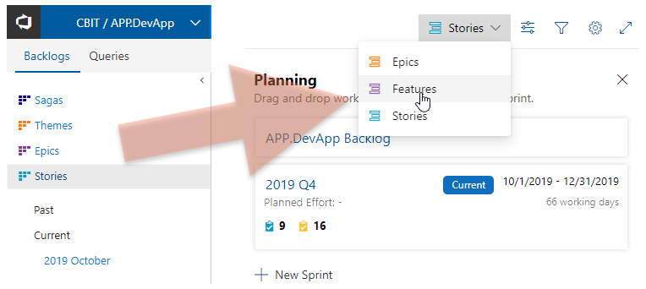
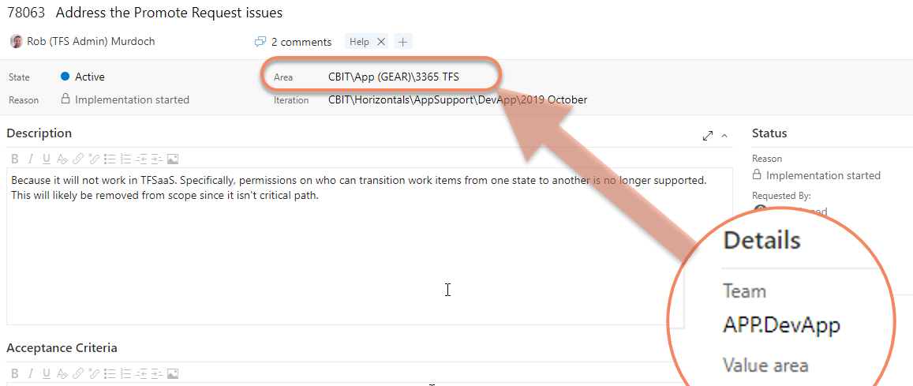
AIG Customizations
Take away - Many of the customizations you aren’t using will go away – small number will be affected
Saga, Theme, Epic, User Story hierarchy change to Epic (hidden by default), Feature, User Story
Who’s using this? (none on in our research)
Need help migrating, let us know.
AIG Team Field to OOTB Area Path
Separate communication to affected teams
We’ll provide migration path
Promote Request
Major overhaul – separate communication
More automation coming

Slide 5
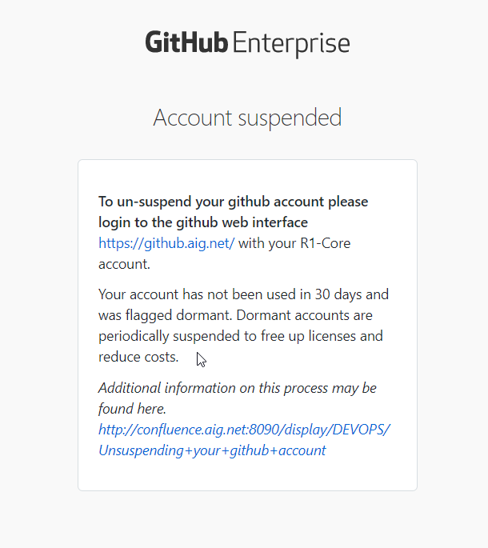
Identity and Access Management
Take away – don’t use it, lose it
Motivated to pay Microsoft based on actual usage
Managing a pool of Basic User Subscriptions (fka CAL)
Visual Studio Subscriptions excluded (get ‘em associated)
Every 30 days, don’t use it, access level reduced to
Subscriber Access Level (free tier)
Terminations
License removed from pool

Slide 6
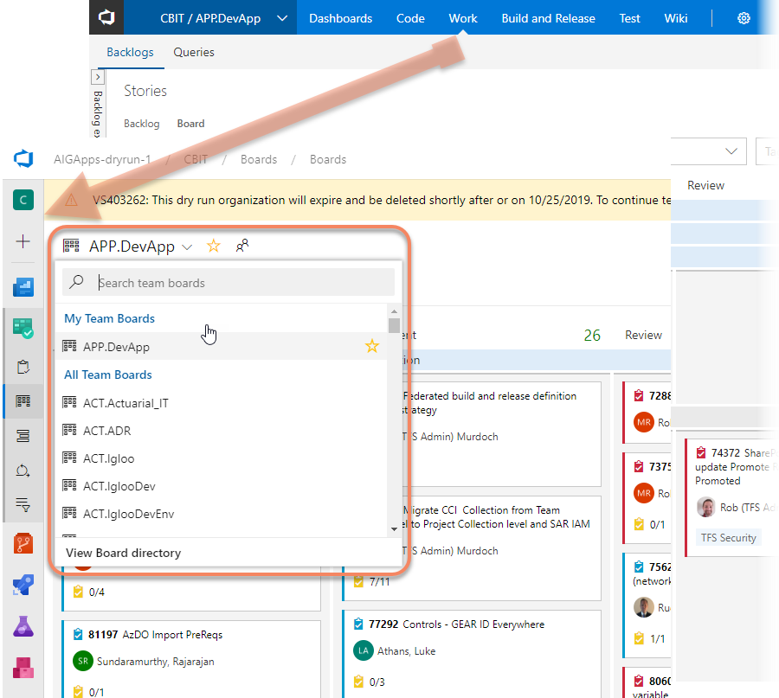
New User Experience
Take away – It is discoverable, but you should visit it once before go live
Navigation
Moves to left
Search for teams
What’s new
Pipeline folders
Audit

Slide 7
Nuance
Minutia you can probably guess
On a given Monday, you’ll change your browser short-cut – duh
Source Code
TFVC Workspaces migrate
GIT Repos will need to update your remotes
Excel Team Foundation Add In
Stop using it (deprecated)
git remote set-url origin

Slide 8
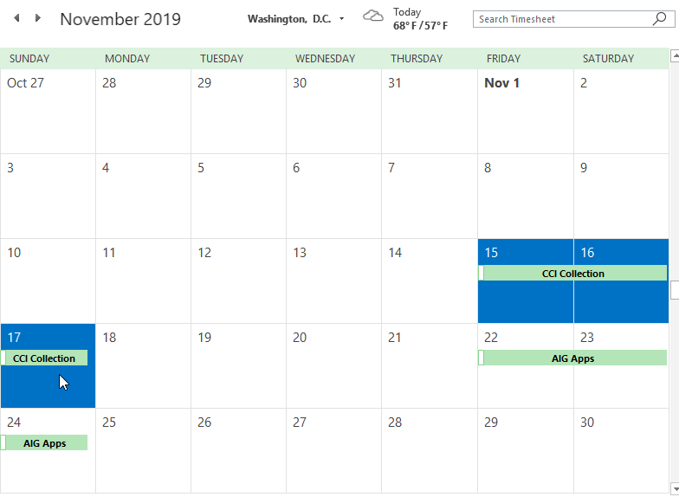
Timeline
Take away - Q4 2019
Pull ahead work
Oct, early November
Migration - CCI collection
No PRs, No Heirarchy, No Team Field
Migration - AIGApps
23rd November
3 day event starting Friday COB (EST) to Sunday 8:00 P.M. (EST)
AVP testing from 3-8 Sunday
Cloud freeze might cause a delay

